Slide 1
Arithmetic operations and mathematical expressions
By: M Usama
Code with MU

Slide 2
Arithmetic operations
Many operators use for manipulating numeric values and performing arithmetic operations.
They totally work on mathematical expressions.
4+2
operand
Code with MU
operator

Slide 3
Arithmetic operations operations
Symbol | Meaning | Type
+ | Addition | Binary
- | Subtraction | Binary
* | Multiplication | Binary
/ | division | Binary
% | Modulus | Binary
Code with MU

Slide 4
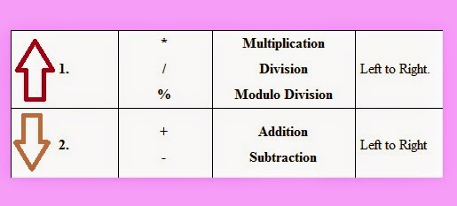
Associativity in arithmetic operations
Example:
2+3%5/6-3+6*5*4/2+3
Code with MU

Slide 5
Mathematical expressions
Arithmetic operations are used to form mathematical expressions
Basically mathematical expressions is like an equation in which arithmetic operations used.
Every mathematical expression have arithmetic operations .
Code with MU

Slide 6
Examples of mathematical expressions
total = cost + tax;
cost = total − tax;
tax = cost * rate;
salePrice = original / 2;
remainder = value % 3;
Code with MU

